Slide 1



Sistem Informasi Rental Mobil Travelo Tour & Travel
SIREMOTRA

Slide 2



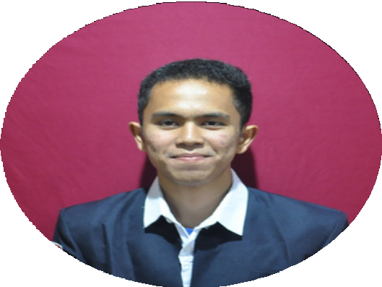
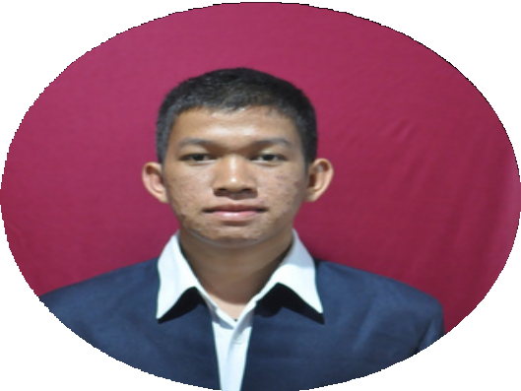
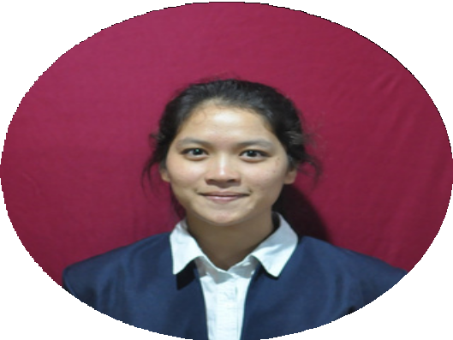
Join to my team
Kelompok 10
12S18006
Mei Panjaitan
12S18013
Yudika Purba
12S19010
12S19032 12S19053
Gabriel barimbing Natanael Tambun Elysa Pangaribuan

Slide 3

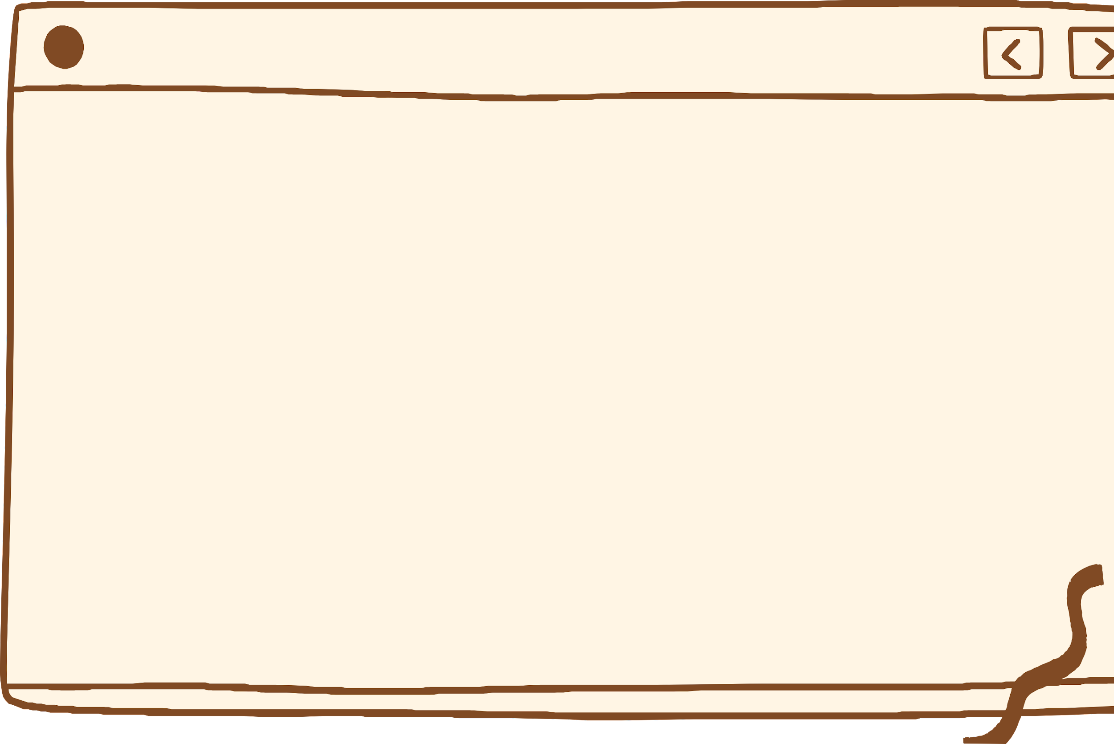
Descriptio^{n}
_{This} Car Rental Information System development project _{is an assignment from} the Informa^{tion Systems Project}
_{course. This} car rental inf^{ormation system will be used} _{by Traveleo T}our & Travel, ^{which has been operating as a} _{car} rental business for a long time. Because of Pandemic, not a few tenants are lazy to place an order be^{cause they} _{have to place} an order direc^{tly.}

Slide 4
There are so many problems that occur during the car rental business. Some of them, the occurrence of collisions in booking schedules so that car rental owners find it difficult to make decisions.It's not only difficult to make decisions, car rental owners also find it difficult to find drivers who can drive and drivers also find it difficult to adjust their own schedules. Then the transaction process that must be done in cash makes it difficult for renters to make payments because payments must be made at the car rental
location.

Slide 5

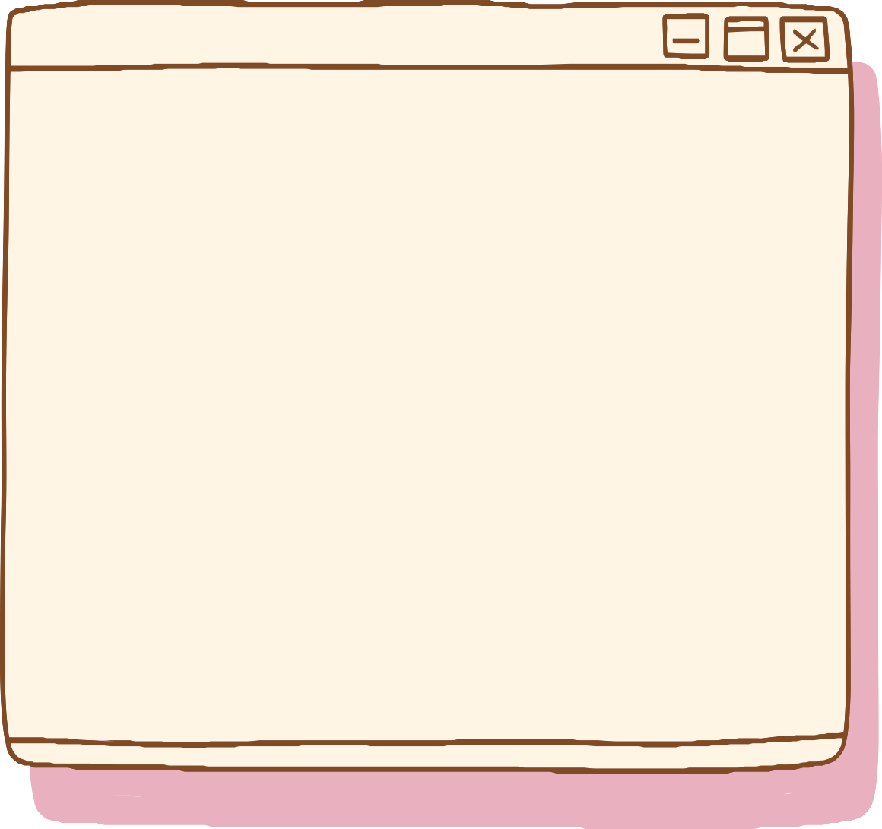


_{Syste}m Purpose
POINT 2
^{To make it easi}er for car ^{renters} to make ^{booking tran}sactions.
POIN^{T 1}
^{POIN}T 3
_{Ass}ist the pro^{ject}
_{owner in m}anaging th^{e}
Help renters to
_{ren}tal proces^{s,}
book a car
_{tra}nsactions ^{and}
tenan^{t data.}

Slide 6
^{- Registration} Function
Functional functio^{n}
^{Login} Function
^{Car Booking} Function
^{C}ar Data Managem_{ent} Function
Functions of Mana_{ging} ^{Oper}ator Data
^{Transaction Report} Function
^{Payment} Function
^{Car Data Viewing} Function
^{Function} of Managing Te_{nant} Data
^{Driv}er Data Managem_{ent} Function
^{Driver Approva}l Function

Slide 7

Non-functional function :
The application must be able to verify when the user wants to enter the system.
Only employees who have been registered in the database can enter the system
Using MD5 password encryption.
The application built will resemble the Tiket.com application.

Slide 8


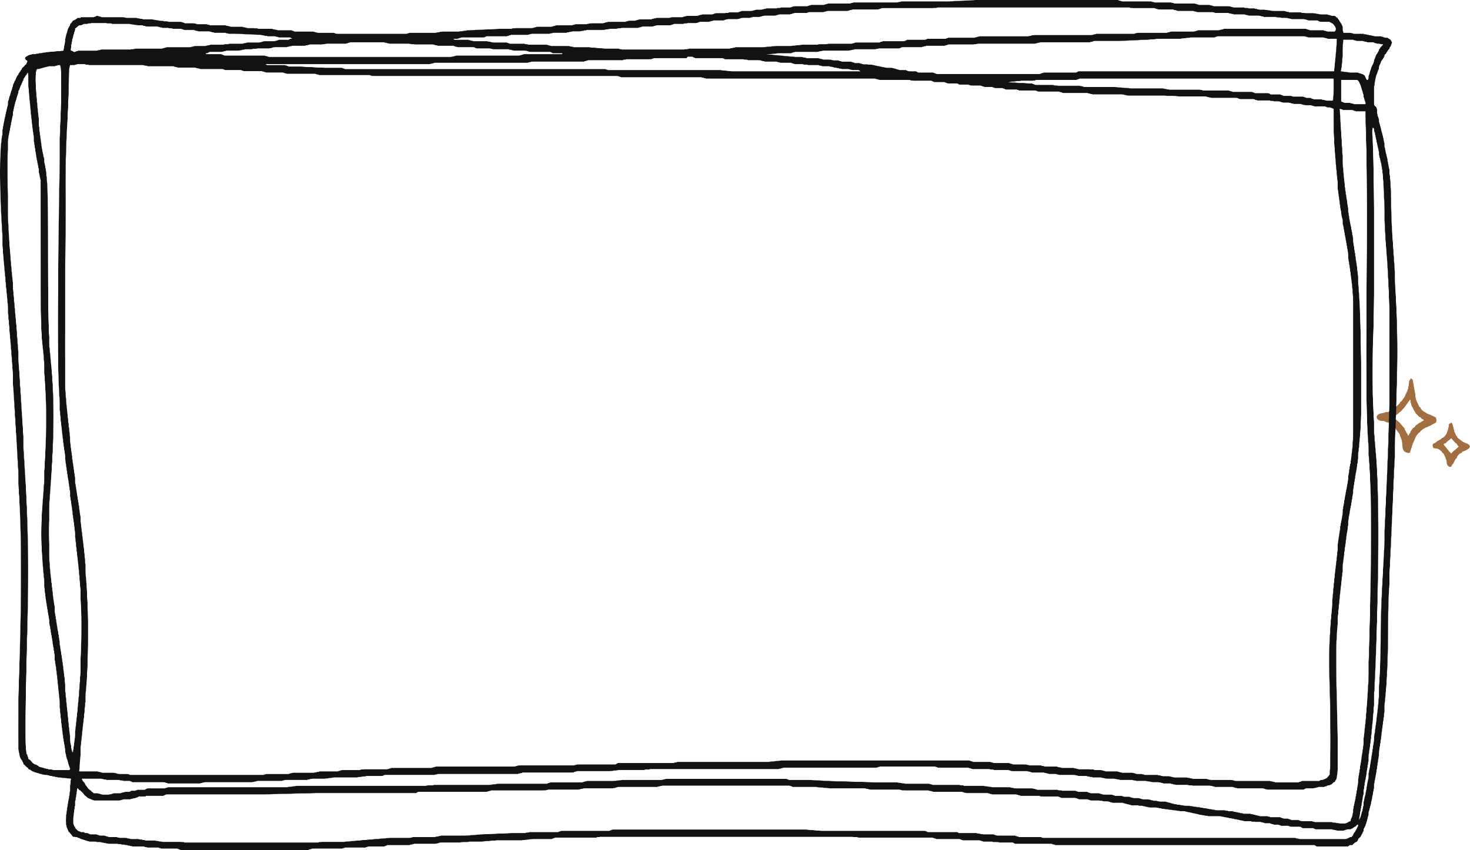




Dashboard

Slide 9


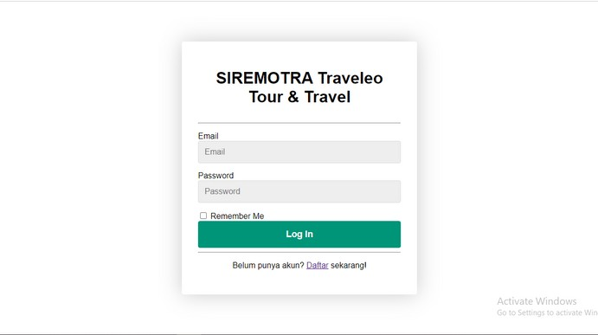
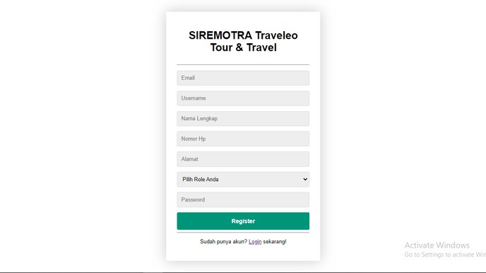
Login& Register

Slide 10
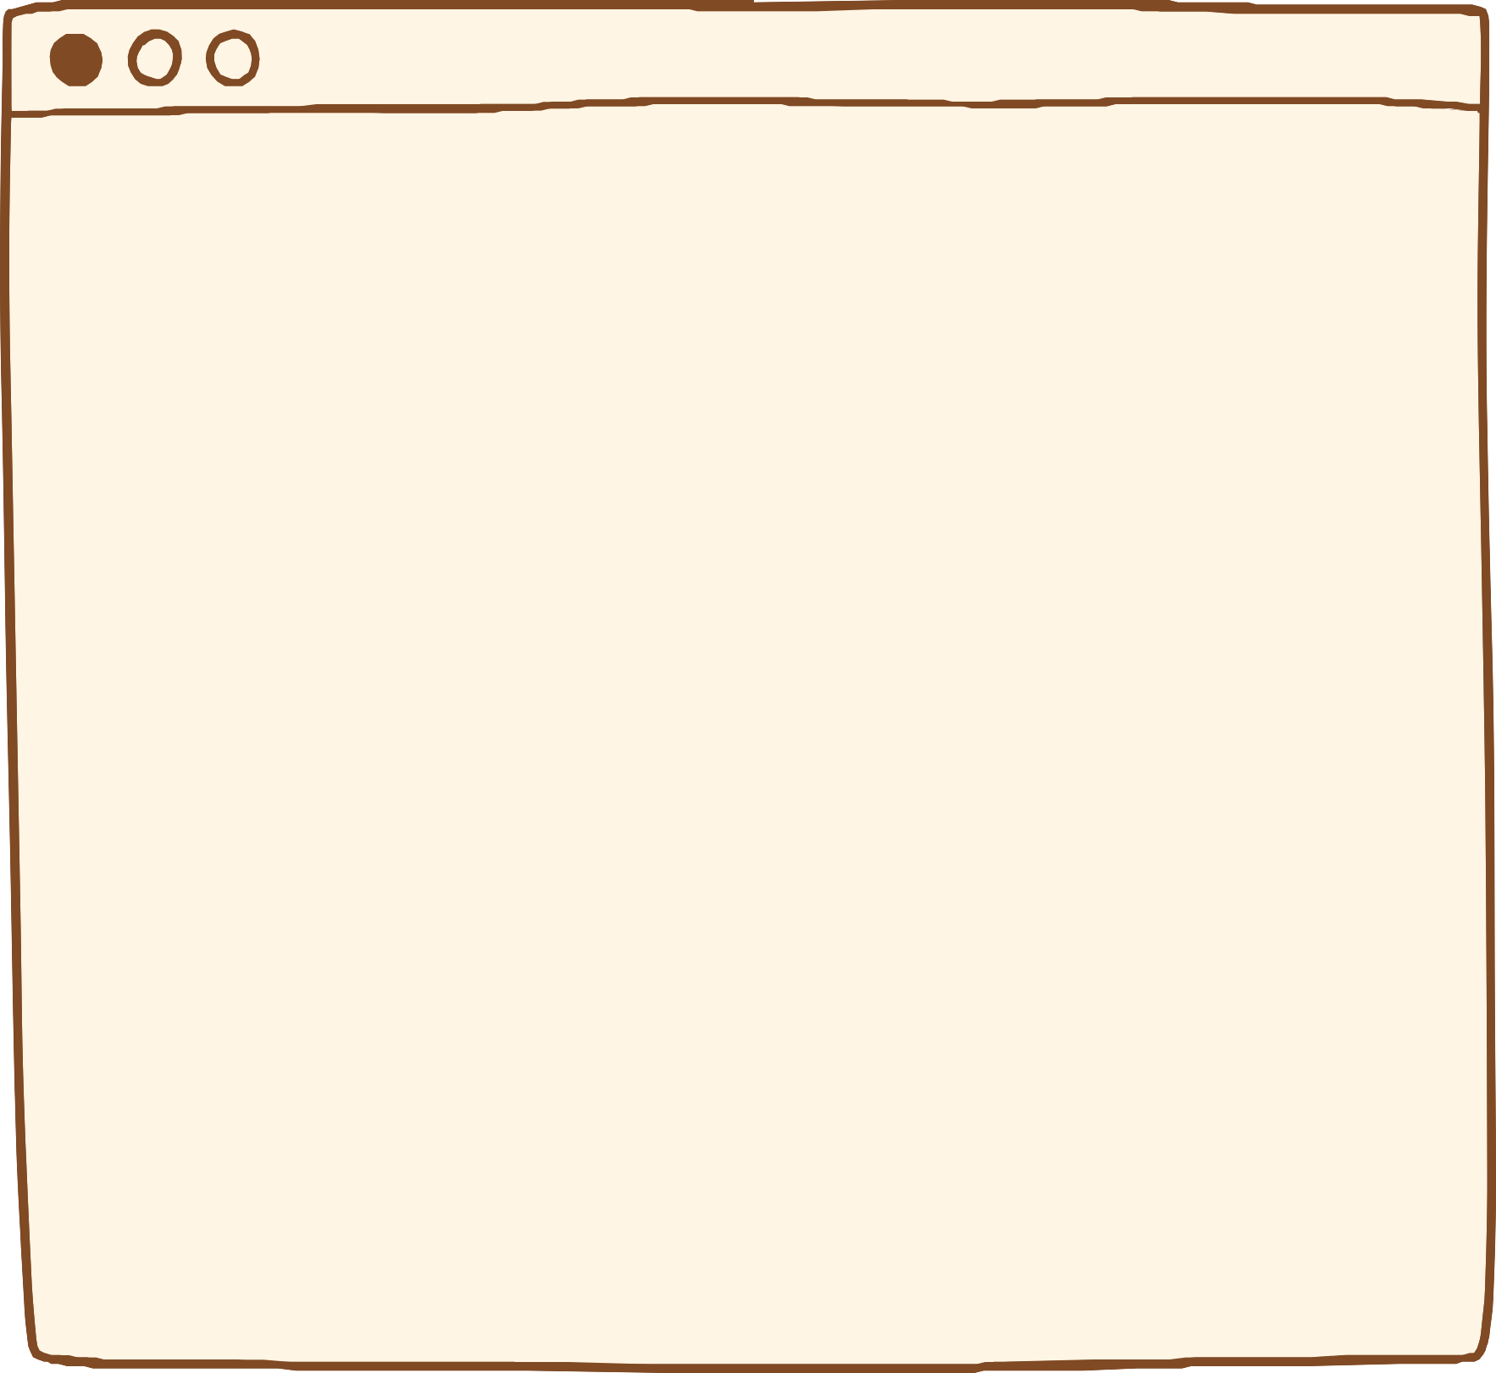
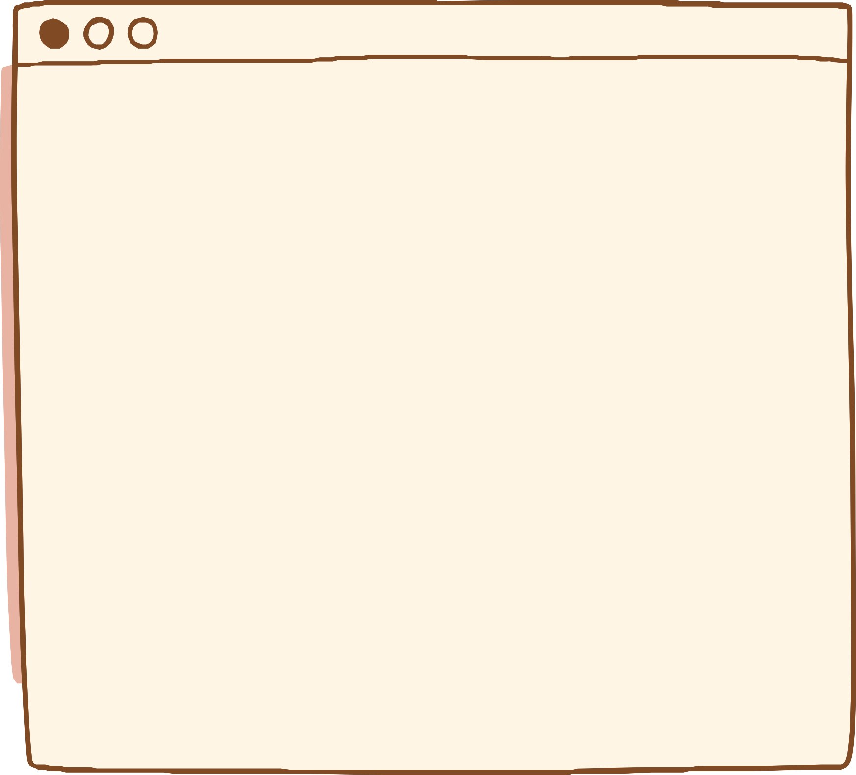
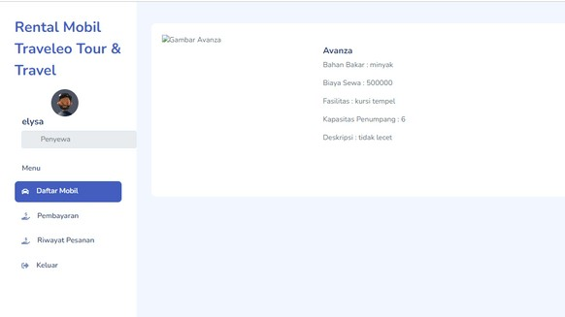
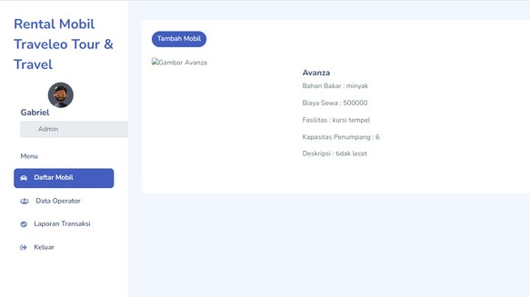
Web Page tenant & ^{Admin}

Slide 11
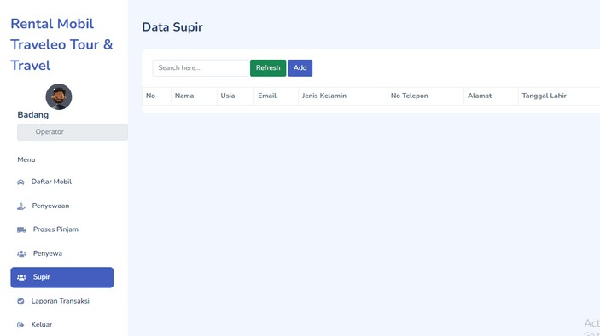
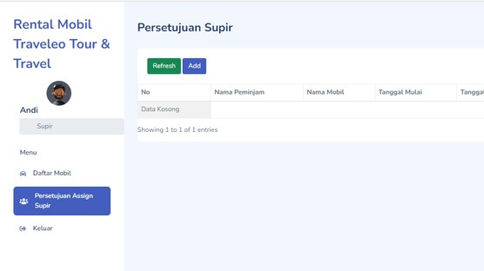
_{Web page} Driver & Operator

Slide 12
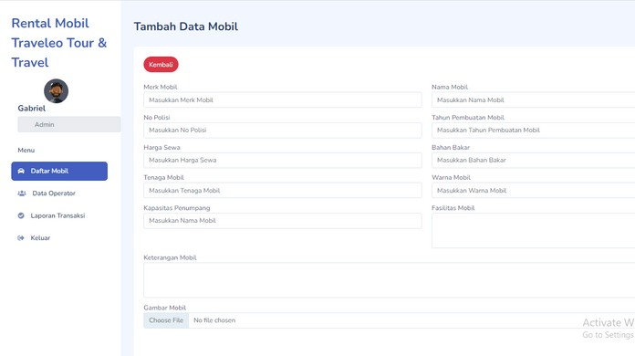
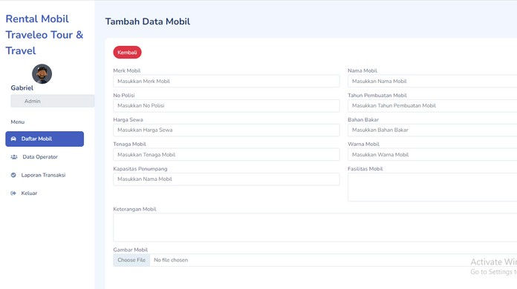
_{Create Cars by A}dmin & operator

Slide 13

make order by ten^{ant}

Slide 14
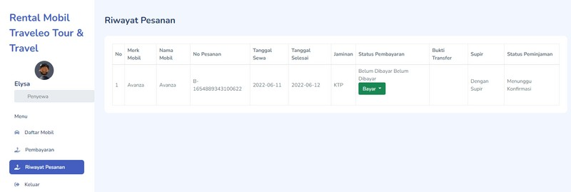
_{Making payment}s by the Tenant

Slide 15
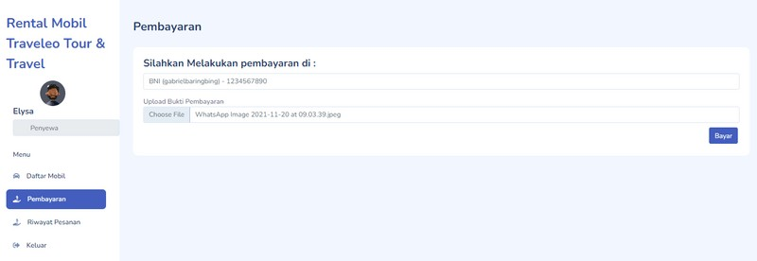
_{Making payment}s by the Tenant

Slide 16
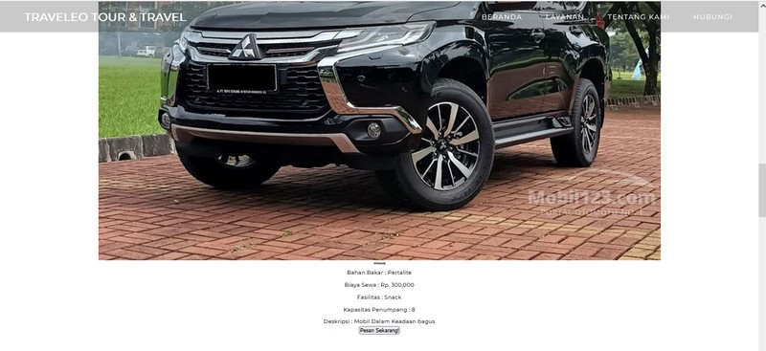
View Car Data

Slide 17
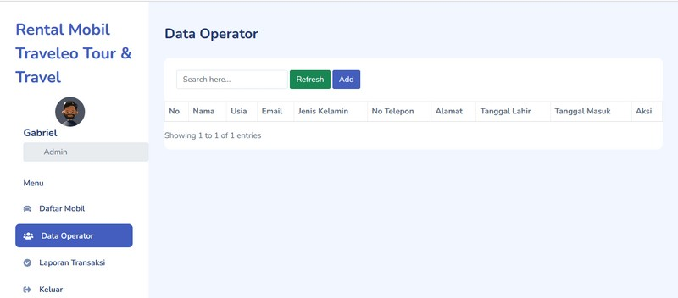
_{Ma}nage Operator Datª

Slide 18
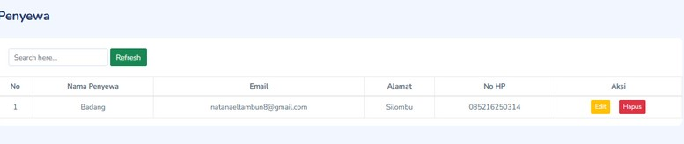
manage tenant data

Slide 19
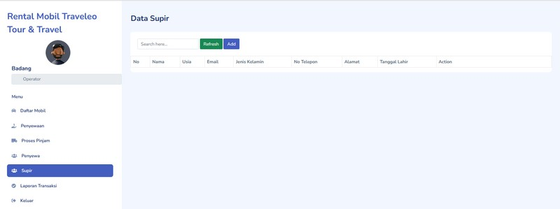
_{Ma}nage Driver Data

Slide 20
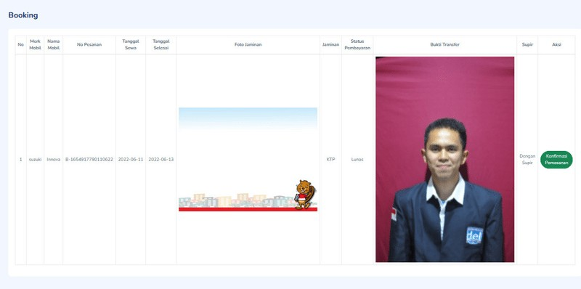
display order confirmation

Slide 21
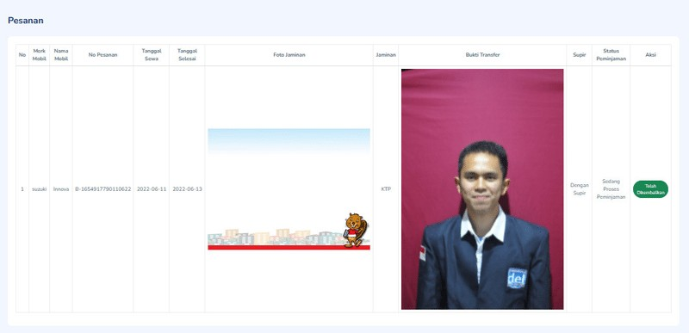
display car return data

Slide 22
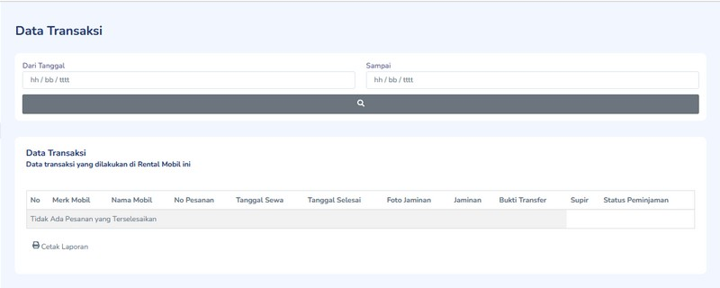
Make Transactio^{ns Reports}

Slide 23
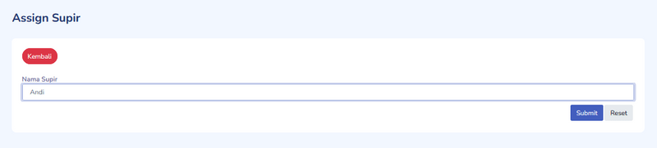
Assign Driver

Slide 24
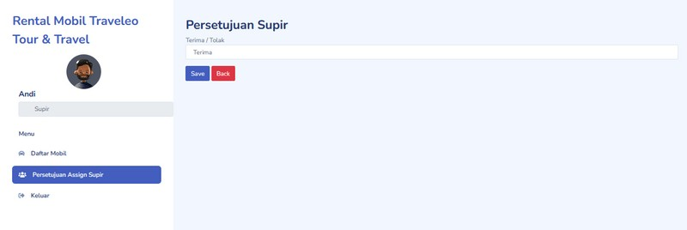
Driver Ap^{proval}

Slide 25



Our Testing Too^{ls}
We use the Black Box method for testing because this test method does not have to change the existing code, but will look at testing the appearance of the system, system functions and matching the flow of functions with targets in the business processes created. This test is focused on the user's point of view so that it can find inconsistencies in the system specifications.

Slide 26

Thank You ^{Very Much}

